Slide 1

hostel MANAGEMENT SYSTEM
Submitted by –
Rishav Raj B170562CS
Gaurav Kumar B170383CS
Shubham Anand B170305CS
Pritam Patel B170418CS
Notes:
NOTE:
To change the image on this slide, select the picture and delete it. Then click the Pictures icon in the placeholder to insert your own image.

Slide 2
INTRODUCTION
“Hostel Management System” is a project which aims to get rid of paper work done by student in order to get a room allotted in NITC hostels and hectic work of room allotment done by hostel admins.
This system also provides an interface through which student can see their current fees.

Slide 3
Scope of Project
A student can signup in the portal and can apply for one of the available hostels.
Student can see their profile details, current fees and room allocation status.
Admin can allocate/deallocate rooms for the students who have applied for his hostel.
Admin can add/remove the room from their respective hostel.
An individual request for the room can also be processed by admin.
Admin can update the fee for a student who belongs to his hostel.

Slide 4
Languages used for development
Front-end development:
HTML
CSS
JS
Back-end development:
PHP
MYSQL

Slide 5
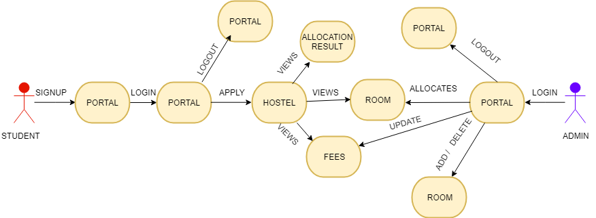
Control Flow Diagram
STUDENT
ADMIN

Slide 6
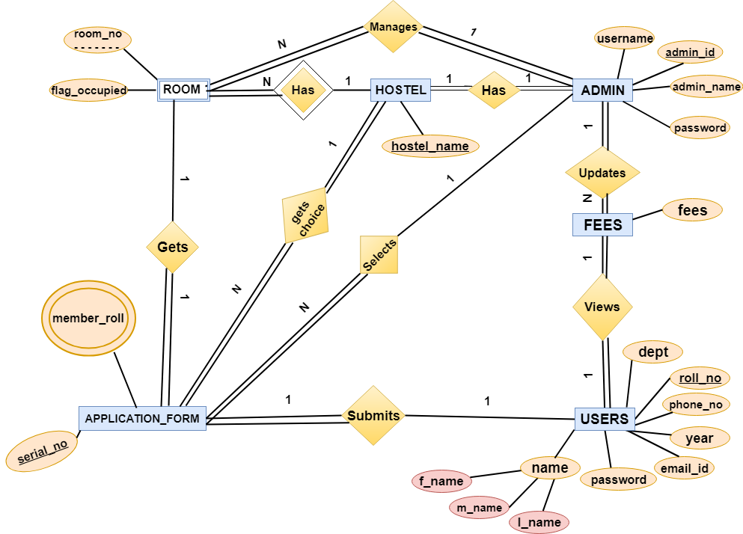
Entity Relationship Diagram

Slide 7
System Features
Admin
Add and delete rooms in his respective hostel
Allocate and Deallocate room for student
Update fees
Student
View profile details
Apply for room
View current fees
View room number allocated to him/her

Slide 8
FUTURE UPDATES
MANAGING INMATES
REGULAR UPDATES OF MESS FEES

Slide 9
Database Tables
USERS
Field | Data type | Default | Key
roll_no | VARCHAR(200) | Not NULL | Primary key
f_name | VARCHAR(200) | NOT NULL
m_name | VARCHAR(200) | NULL
l_name | VARCHAR(200) | NULL
email | VARCHAR(200) | NULL
password | VARCHAR(20) | NOT NULL
phone_no | VARCHAR(200) | NULL
year | INT(6) | NULL
dept | VARCHAR(200) | NULL

Slide 10
Database Tables
FEES
Field | Data type | Default | Key
roll_no | VARCHAR(200) | Not NULL | Primary key, Foreign
admin_id | VARCHAR(200) | NULL | Foreign
fees | INT(6) | NULL
ADMIN
Field | Data type | Default | Key
admin_id | VARCHAR(200) | Not NULL | Primary key
Email_ID | VARCHAR(200) | Not NULL
password | VARCHAR(200) | NOT NULL
admin_name | VARCHAR(200) | NULL

Slide 11
Database Tables
HOSTEL
Field | Data type | Default | Key
hostel_name | VARCHAR(20) | Not NULL | Primary Key
admin_id | VARCHAR(200) | Not NULL | Foreign Key
ROOM
Field | Data type | Default | Key
room_no | INT(6) | Not NULL | Partial key , Primary key
hostel_name | VARCHAR(200) | Not NULL | Foreign Key, Primary key
flag_occupied | boolean | FALSE
admin_id | VARCHAR(200) | NULL | Foreign key
serial_no | INT(6) | NULL | Foreign Key

Slide 12
Database Tables
APPLICATION_FORM
Field | Data type | Default | Key
serial_no | VARCHAR(200) | Not NULL | Primary Key
hostel_choice | VARCHAR(20) | NOT NULL | Foreign key
applicant_roll | VARCHAR(200) | NOT NULL | Foreign Key

Slide 13
SCREENSHOTS

Slide 14
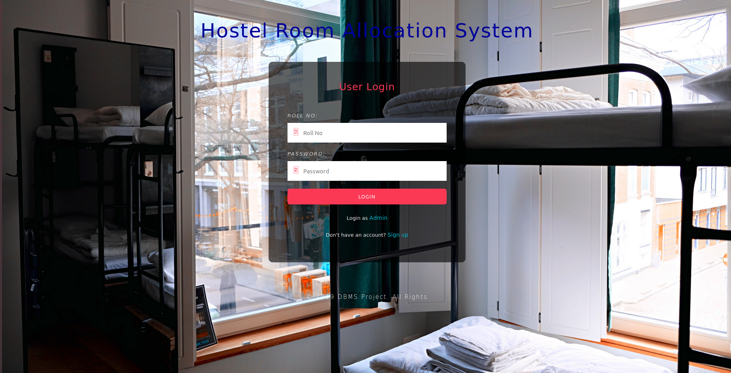

Slide 15
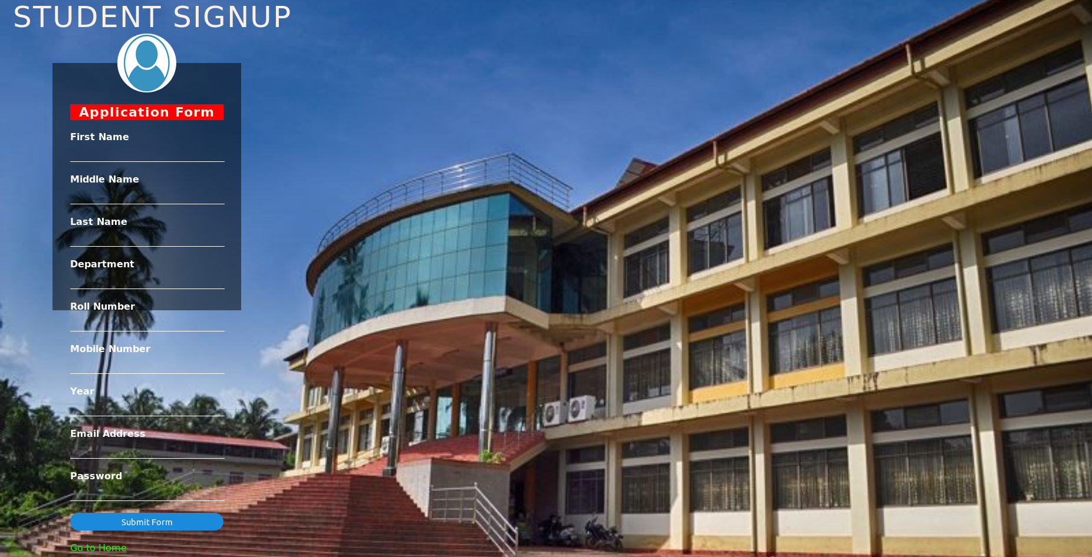

Slide 16
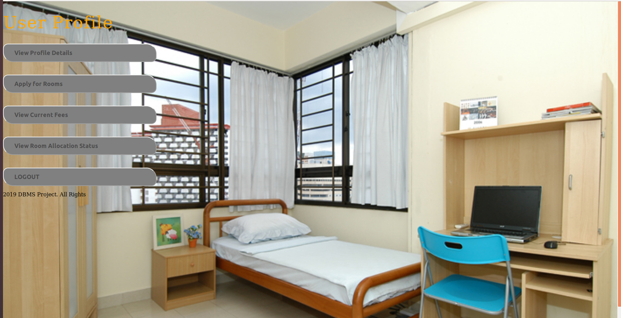

Slide 17
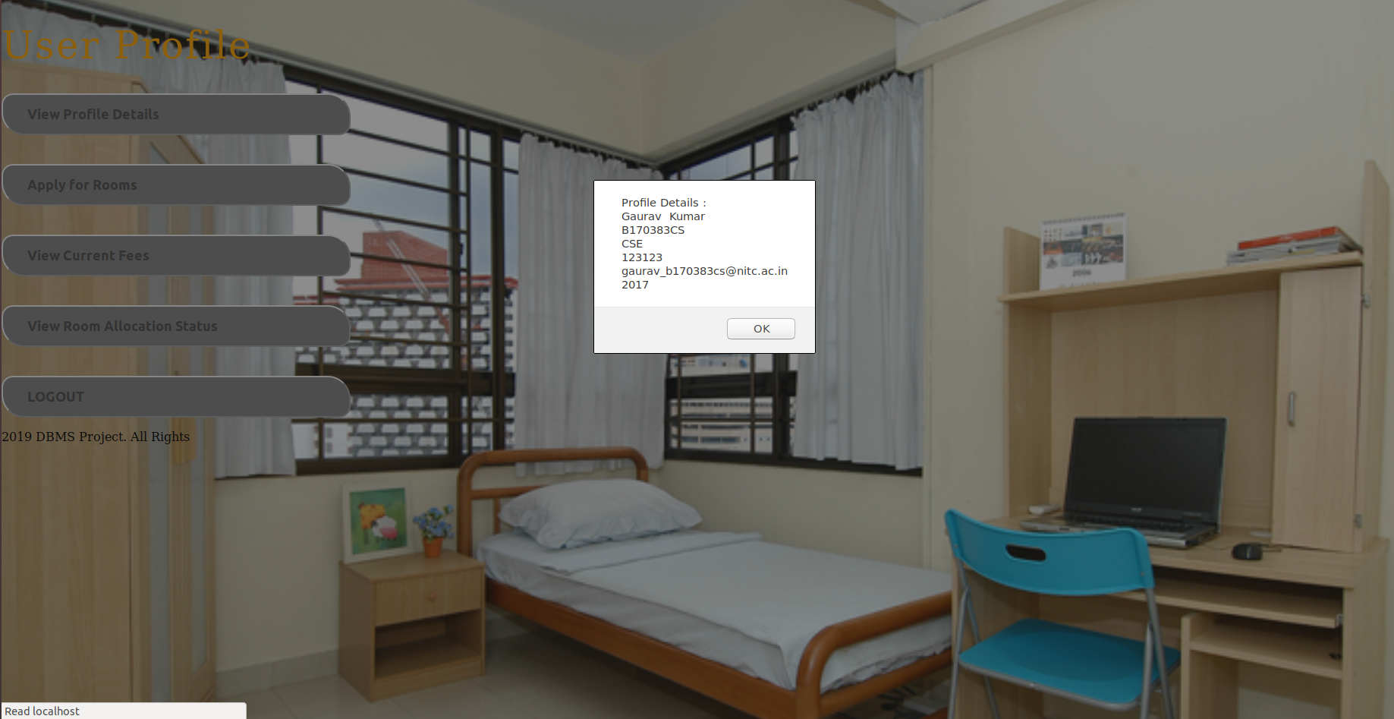

Slide 18
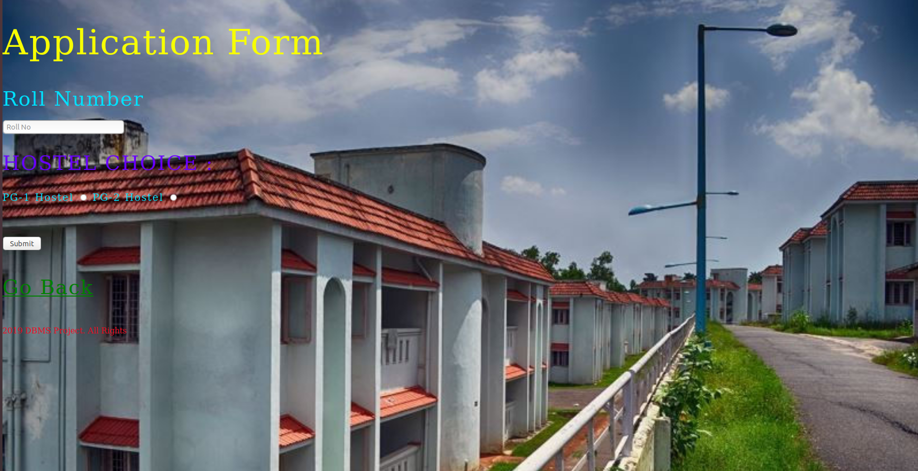

Slide 19
